Slide 1


Food and Shelter to the homeless using Technology during CoVID-19
Team RunTime Terror. – DevHack 2020 DSC KIIT

Slide 2
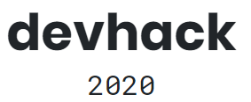
Team Runtime Terror Theme Domain: Healthcare
Members:
Dhruba Das (Team Captain)
Devarghya Ray
Sraman Mukherjee

Slide 3
Problem Statement
Due to COVID-19, a huge number of people in our country are on the streets now with no food and shelter.

Slide 4
Solution
A very efficient distribution system is created- to ensure smooth flow of cooked food using the application of IoT enabled machines, to the home less, also parallelly giving a livelihood to the people who are helpless in the lock down, such as app based taxi drivers, and private tempo/truck drivers/companies , caterers and Vending machine sellers/owners- providing a boost to the economy.

Slide 5

How is the solution implemented? - Part A- Sheltering the homeless
The government must identify the homeless at night,- the same way the number estimates of homeless were made , and shift them to the Quarantine center that is to be set up in each Ward of the hotspot metro city (QCW) dedicated to the homeless. App Taxi drivers can help ferry the homeless to the QCW. They are paid by the government.
Each QCW will take biometrics of each person shifted there. A database will be set up, and data will be sent to the Central Processing Unit (CPU) (to be set up at the heart) of the city.
(details explained in the upcoming slides)
This covers the shelter part of the solution. The next few slides cover the food distribution system using iOT enabled vending machines

Slide 6

How is the solution implemented - Part B- Food supply and logistics
We take the case of Southern Metro cities- BLR,Hyd, Chennai. They have a homeless population of approx. 5000 people each. Each city has 150 wards, so on average 33 people per ward.
In our solution we keep a 400% buffer to the number of homeless people, so that the system does not crumble, in-case the numbers have changed due to CoVID 19, i.e. to accommodate 20000 homeless per city, with minimum food wastage.
Also, another aim, is to use minimum contact between people, but also keep more people employed.

Slide 7
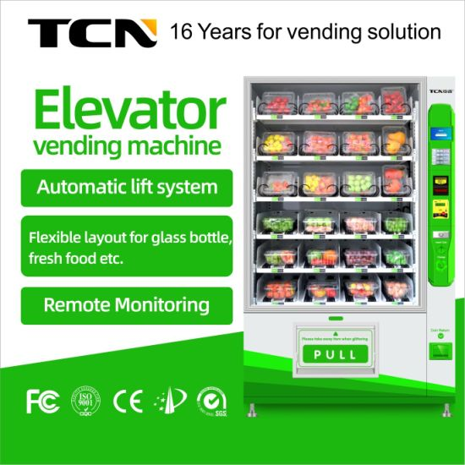
Food supply distribution
A CPU is set up in the centre of the city, which acts like a mass producing factory of cooked food, and has the responsibility of dividing the food into individual meals (packets). Food shall be cooked by caterers who have been given contracts by the government.
These meals are transported to the QCW’s via private trucks, cabs, funded by the govt, and loaded onto the vending machines that have been installed in the QCW’s. Each truck covers 5 wards, and a total of 30 trucks will be required, for 3 trips, i.e Breakfast , Lunch, Dinner. The route taken by the trucks can be sorted by tree traversal algorithms- to maintain maximum efficiency- each QCW is a node.
Each vending machine can store ((4rows *6colums *5depth)=120 meals. The latest vending machines (like the ones used by Big Basket Instant) are connected to the internet (IOT) and can store bulky goods in them, and can provide an accurate count of meals stored/ left. The vending machine updates the CPU on how many meals are left in it, so that they can send the appropriate number of meals in each trip. These machines are refilled 3 times a day.

Slide 8
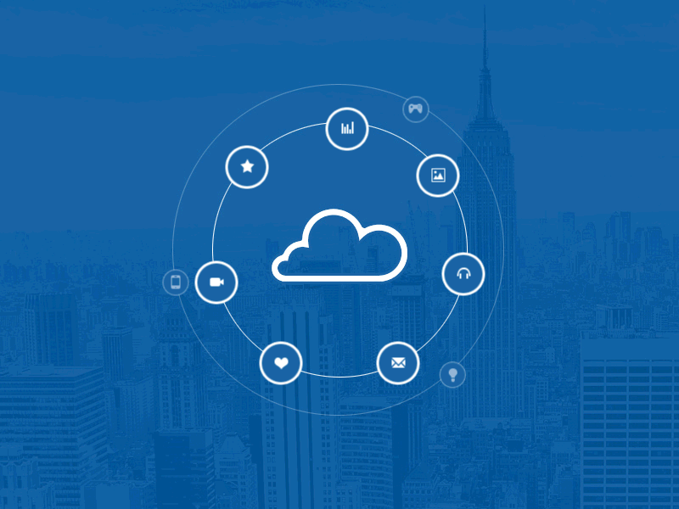
How the machine works.
The machines are totally user friendly. The person who needs the meal, will give his biometric, and the machine unlocks, and he can pick the food. The caretakers, at the QCW’s can assist, because no training is required to operate these machines.
Minimum man power is required, and thus the delivery of food to the care seeker is contact less. As soon as a single meal is taken out of the machine, the CPU gets the information via the internet, to prepare enough meals, to reload the machine (Minimum wastage)
A total of 1 vending machine is required per QCW, therefore 150 machines in a big metro city.

Slide 9
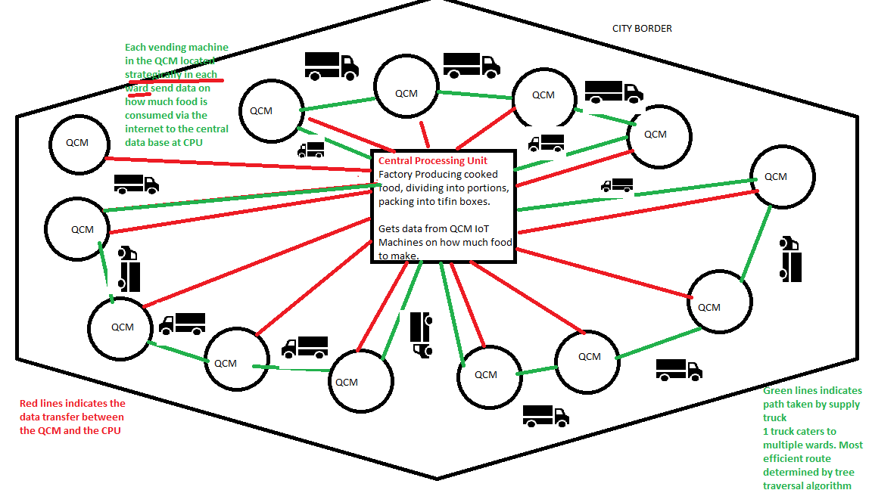
Architecture diagram

Slide 10
Business Model
The vending machine Companies/ owners get a profit by selling/ renting/leasing machines to the government
Private players such as App based Taxi drivers, Truck/tempo drivers, and restaurant cooks (employed at the CPU) get a paid livelihood.
The economy gets a boost even during lockdown, as apart from the above beneficiaries, the surplus fuel will be consumed too.
The relief funds donated by the citizens can also sponsor the cost borne by the government
We have the funds, we have the people. The solution can be easily implemented.

Slide 11
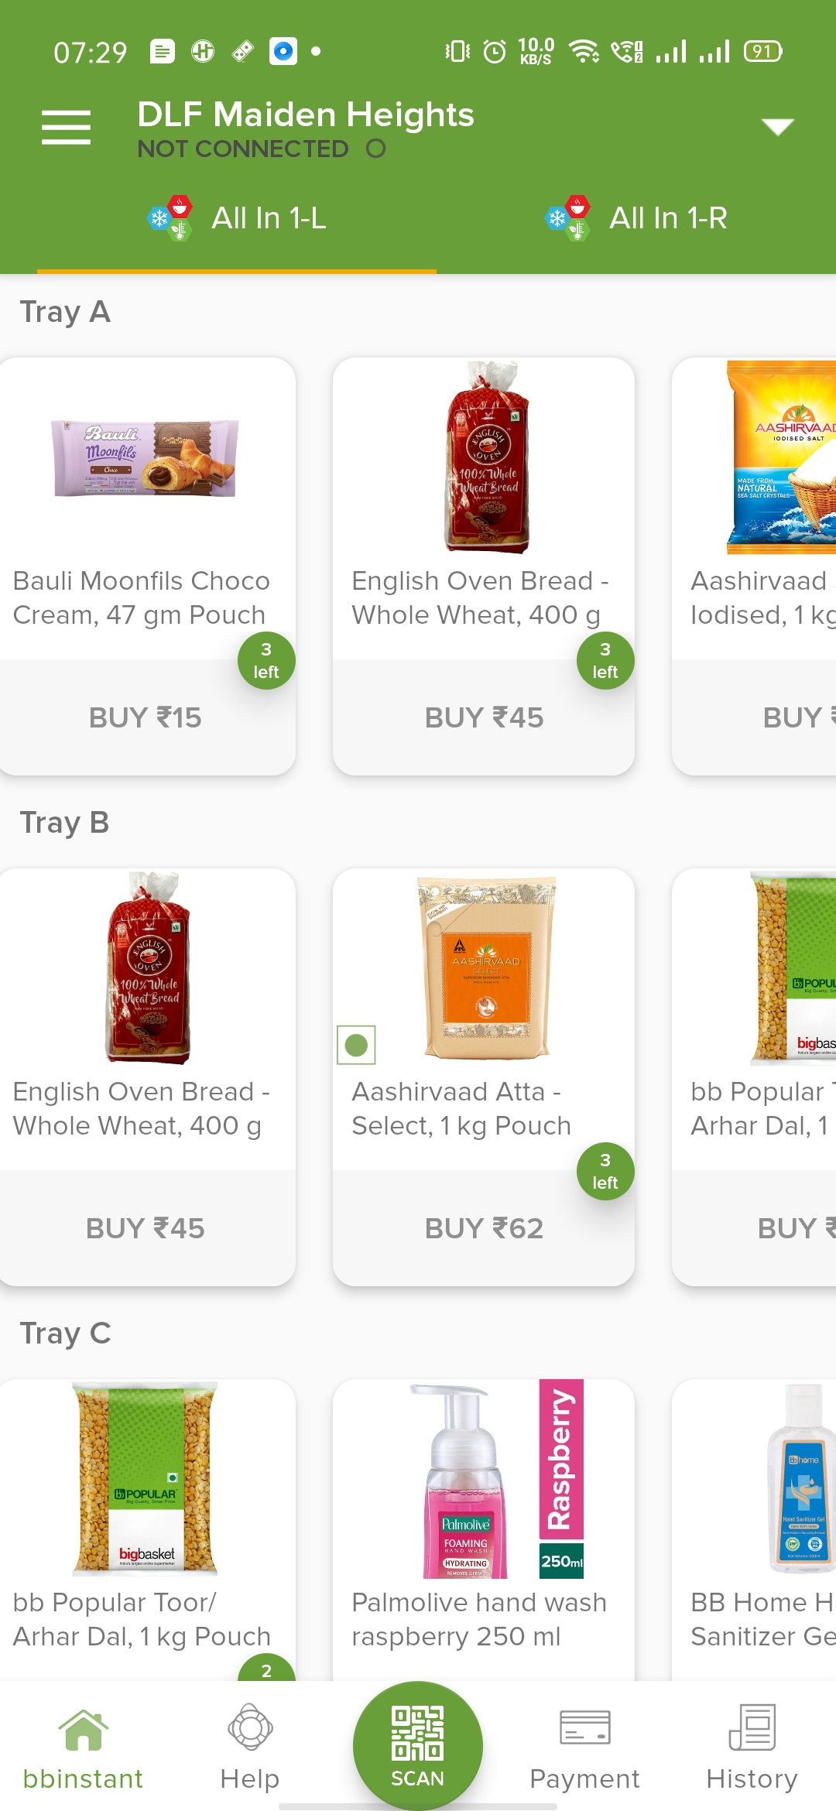
FAQ’s – Frequently Asked Questions
Q1 Isn't the tech used in the project seem to be too expensive?
Ans. The vending machines cost 1 Lakh INR each (including internet and electricity costs) so per state it is 1.5 crore. 1.5 crore INR can easily be allocated from the central and state government budgets and relief funds. Also if possible the government can lease/ rent these machines from owners/ manufacturers. Also costs can be reduced by employing Government State Transport Corporation employees (KSRTC, WBSTC, etc) , for driving the rented trucks, as they are already being paid by the government, and have the appropriate driving licenses. Health>>>Money. If everything gets back to normal as soon as possible, the economy can restore itself, even with people being restricted.
Q2 How does this iOT enabled vending machine work? Prototype? I have never heard of an iOT enabled vending machine? Do they exist?
Ans. Yes, they do exist- in India!. Our solution uses the same type of iOT enabled vending machines used by the service Big Basket instant- installed in Dhruba’s apartment. We can see the items in the machine, from our smartphones at home, if we like something, we go to the machine, pay through the app, and get the item we want! It’s that simple. In the backend the machine sends data to the BigBasket Warehouse, the amount of each item is left. At the end of the day/ next day they come and fill up the machine again. In my solution, we use A biometric system, instead of an app, to track how many times the vending machine is used, and by who? For the prototype it requires a simple modification of code from the vending machine manufacturer’s side, to implement the biometric system. Or any alternate system, can be worked out with the manufacturer
The vending machine app as described in Q2

Slide 12
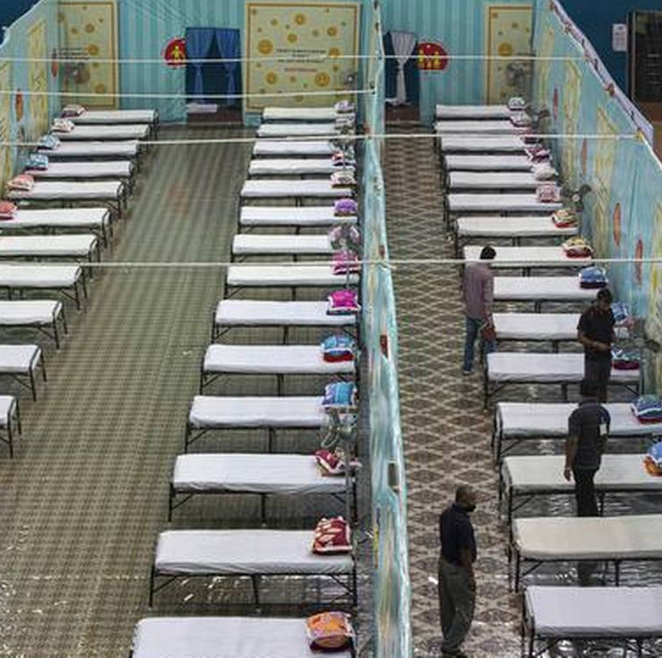
FAQ’s – Frequently Asked Questions
Q3 How are the QCW’s going to be built so fast? Isn't it the need of the hour?
Ans. The QCW’s will take some time to be built by the government, in each ward. So, in the meantime the government schools and colleges in each ward can be used as temporary QCW’s. All schools and colleges will be disinfected and thoroughly sterilised before reopening to students. By that time the QCW’s will have been built.

Slide 13


THANK YOU :D
Let’s win the Co-VID 19 WAR together, yet separated, maintaining social distancing!
Special thanks to:---------->
For their dedicated hard work in organising this hackathon, during the lockdown

